Slide 1
Design and Simulation of a Digital Door Access Control System
Module 2 Project: Combinational Logic & the ALU
Team Members
2620030002-Siri
2620030025-Bruhathi
2620030033-Varshitha
2620030037-Kruthika

Slide 2
Introduction and Objective
Introduction & Objectives
Advantages
A digital door lock opens only when the right person gives the right credential. Our design compares a 4-bit PIN typed on switches with a stored PIN, checks that the card is valid and that the system is not locked out, then drives the correct door lock.
It uses only combinational logic: the output depends only on the current inputs, with no memory.
Objectives
Apply K-maps, comparators, MUX and decoder from Module 2
Go from specification to a working Logisim simulation
Verify every input case with a truth table
Link the compare logic to the ALU's set-less-than function
Very fast: output settles in a few gate delays
No clock or memory, so simple and low cost
K-map minimised, so fewer gates and less power
Easy to test with a complete truth table
Scalable: wider PIN or more doors by adding gates
Disadvantages
No memory: cannot count failed attempts by itself
Fixed hardware PIN: changing it needs rewiring
Short 4-bit PIN has only 16 combinations
Wider comparators need more gates and delay

Slide 3
Theory and Logic Circuit
Combinational logic
Output depends only on current inputs: no memory, no clock.
Equality comparator
Mi = XNOR(Pi, Si) for each bit, so Match = M3 · M2 · M1 · M0.
Lockout (3 failed attempts)
L = A1 · A0. Same idea as the ALU's set-less-than: allowed while attempts < 3.
Grant and door select
Grant = Match · Card · L'. A 2-to-4 decoder sends Grant to door Dk when U1U0 = k.
K-map insight
Grant has one minterm (M=1, C=1, L=0), so no groups form and the 3-input AND is already minimal. XNOR cells are diagonal, so XNOR is used.
Circuit block diagram
Entered PIN P3–P0
4× XNOR + AND4
Match M
Stored PIN S3–S0 (2:1 MUX)
AND3
Grant = M·C·L'
2→4
Decoder
Card valid C
Attempts A1 A0
AND2
L = A1·A0
User ID U1 U0
Door locks D0–D3

Slide 4
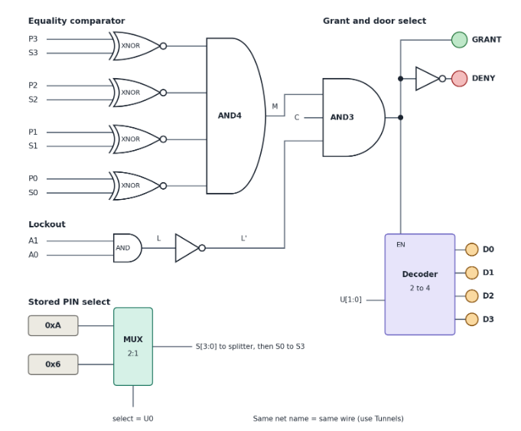
Circuit Design in Logisim
Insert your Logisim circuit screenshot here
(full circuit view with labelled pins)
Components used
Input pins: PIN, Card, Attempts, User ID
2:1 Multiplexer to pick the stored PIN
4 XNOR gates, AND gates (4, 2 and 3 input), NOT gate
2→4 Decoder and LED output pins
How the circuit works
Set the PIN, card and attempt switches.
Each XNOR outputs 1 when its two bits match.
AND4 gives Match = 1 only if all 4 bits match.
Lockout turns 1 when attempts reach 3.
AND3 gives Grant = Match · Card · L'.
Decoder lights the LED of the chosen door.

Slide 5
Simulation Results
Truth table (stored PIN = 1010, user 0)
Entered PIN | Stored PIN | Card | Attempts | Match | Lockout | Access
1010 | 1010 | 1 | 00 | 1 | 0 | GRANTED
1010 | 1010 | 0 | 00 | 1 | 0 | DENIED
1011 | 1010 | 1 | 01 | 0 | 0 | DENIED
0101 | 1010 | 1 | 10 | 0 | 0 | DENIED
1010 | 1010 | 1 | 11 | 1 | 1 | DENIED (locked)
0000 | 1010 | 0 | 00 | 0 | 0 | DENIED
Door select (2→4 decoder, active only when Access = 1)
U1 U0 = 00 → D0 01 → D1 10 → D2 11 → D3
Verified: Grant = 1 only for the row with matching PIN, valid card and no lockout.

Slide 6
Conclusion and Applications
Conclusion
Applications
Possible improvements
A combinational door access system was designed and simulated in Logisim.
Every input combination matched the truth table.
Access is granted only with a correct PIN, valid card and no lockout.
K-maps, comparators, MUX and decoder from Module 2 worked together, the same blocks that build the ALU, the CPU's first major sub-system.
Homes and apartment entrances
Offices, labs and hostel gates
Lockers and safes
Server rooms and restricted areas
Parking barriers and elevators
Add a counter (sequential logic) to count failed attempts automatically
Use a longer PIN or add RFID and keypad
Store PINs in memory so they can be changed
Add a buzzer alarm and timed re-lock

